Slide 1


Nirav Raje Capstone
Machine Learning Guild Apprentice Program

Slide 2
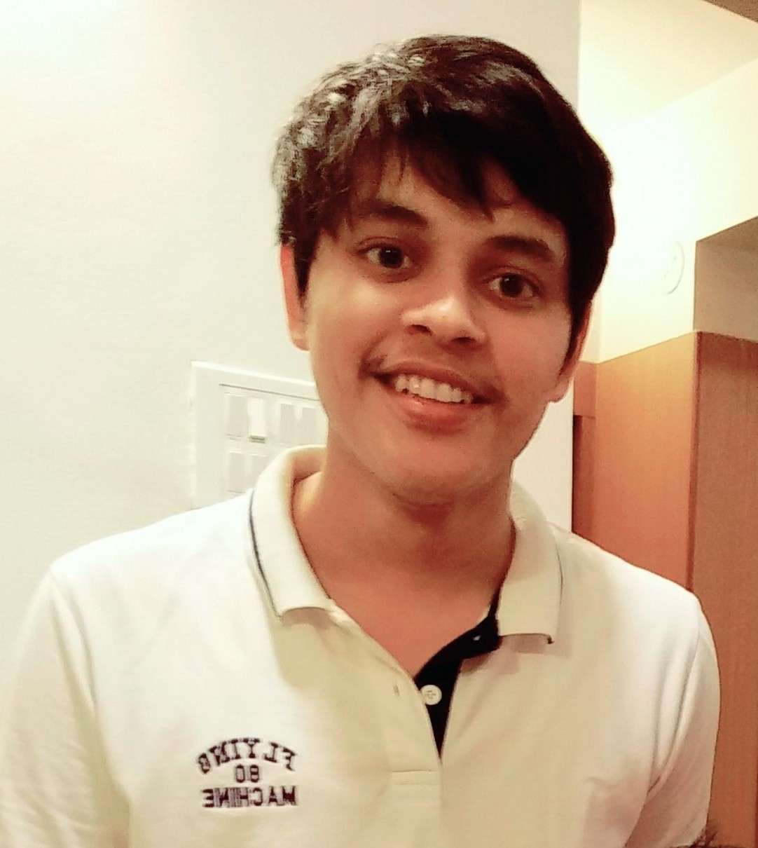
Introduction – Nirav Raje
Why am I learning about Machine Learning and Artificial Intelligence?
To contribute in making ML more accessible through web or Android apps.
To be capable of narrating the story behind the data/modeling to the stakeholders and to contribute to making ML more interpretable.
Biographical Details
Level: Analyst
Offering Portfolio: HRT (HC)
Offering: Workday Integration
Industry / Sector: Technology, Media and Telecom

Slide 3
Capstone
Overview & Major Highlights

Slide 4
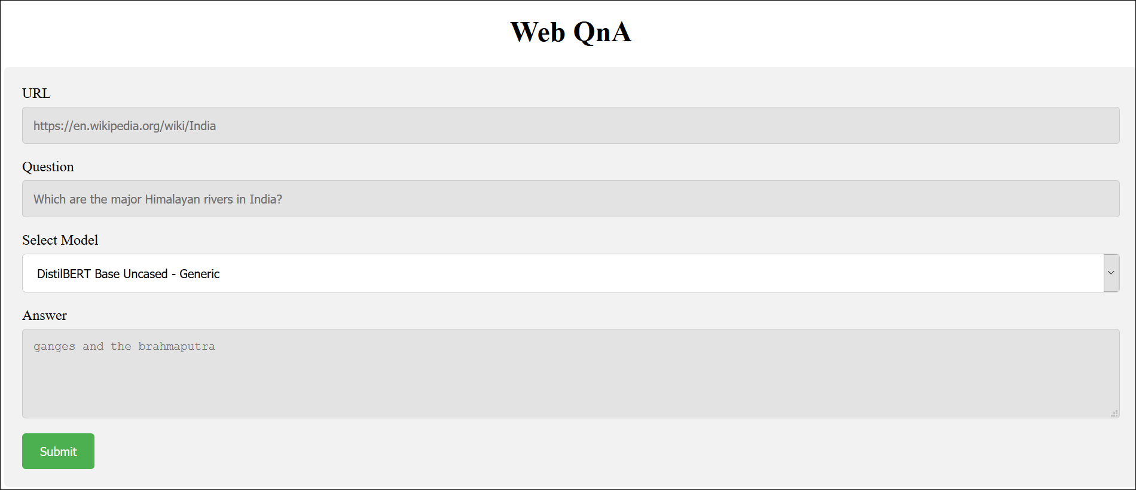
Question Answering System for Web Pages
A web app that allows the user to ask questions on any web page.
ISSUE
SOLUTION
We rely on Google for most of our questions. The search engine has a ~92 market share and receives around 40K search queries every second.
Reason: Google does a really good job at retrieving the most relevant document to our question or sometimes populates the answer directly.
However, after opening a document, there is no easy way to ask follow-up questions that are specific to the content on the web page.
The in-built Search feature (Ctrl+F) relies on direct word matching – doesn’t really take any effort on understanding our question. Frustrating if there are too many instances of the word/phrase we are searching.
Regular expression approaches doesn’t consider similar meaning words.
A web application that can scrape natural language text from any web article and leverages modern NLP techniques to answer a question input by a user.
Task 1: Real time web scraping and pre-processing the article text and the question.
Task 2: Generation of a “context” i.e. generating a paragraph of sentences which are most likely to contain the exact answer.
Task 3: Extracting the exact answer phrase from this context using a deep learning model.
IMPACT
We need a smarter user-friendly tool that “understands” our question, “reads” the long text for us on a semantic level and then returns the exact answer.
Such a tool would save research time and efforts in reading long articles – basically do the reading for us.
Provide a much more efficient alternative for the direct word matching search.
4

Slide 5
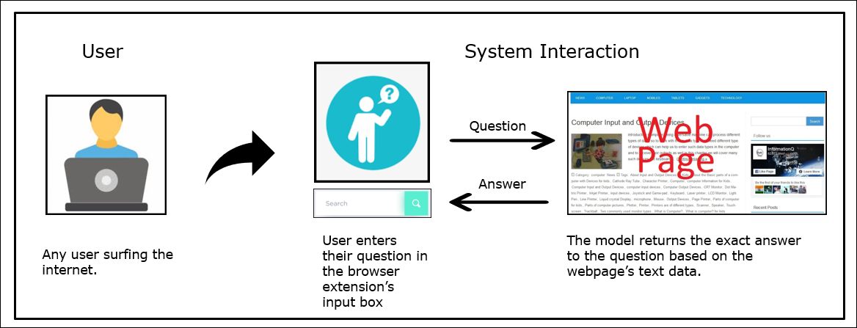
Question Answering on Web Pages
A web app that allows the user to ask questions on any web page. Given a URL, the model returns an answer based on the text contents of the web page.
ISSUE
We usually use Google to search for any question we have on our mind. Google retrieves the document most relevant to our question or sometimes populates the answer directly. However, there is no easy way to ask natural language questions on specific content such as a new article, blog post or a legal document. The in-built Search feature (Ctrl+F) relies on direct word matching and does not really take any effort on understanding our question.
IMPACT
SOLUTION
In our fast paced world, having a tool (a Chrome extension or web app) that “understands” our question and the document’s text on a semantic level and then returns the exact answer, would save a lot of time and efforts in reading long text articles. This also provides a much more efficient replacement for the direct word matching search which we have to resort to, on long web articles.
Deep learning NLP models like BERT, BiDAF, etc are highly efficient in extracting answers from a general context.
Since these models usually have a “max sequence length” limit, it is necessary to “retrieve” the relevant context to the user’s question and then feed the “question+context” to the BERT model.
Hence, this system approaches the problem in 2 tasks:
Context Generation
Answer Extraction
5
Notes:
UI SS
Less details

Slide 6
Approach Overview
Web Text
Data
Text Pre-processing and
Tokenization
Generate
Word Embeddings
(GloVe)
Generate
Sentence Embeddings
(InferSent)
Real-time web scraping of text using BeautifulSoup4
Map 0s for Segment A and 1s for Segment B tokens
Segment A
Tokens
Context is built using the top ‘N’ most similar sentence embeddings to the question embedding.
Condition:
(Question Tokens + Context Tokens) < 512
Cosine Similarity Search
(Generating
Embedded
Context)
Distil
BERT
Context
Sentence
IDs
Context
Tokens
Mapping
Segment
IDs
Question/Query input by user
Question
Tokens
Question
Text
Text Pre-processing and
Tokenization
Generate
Word Embeddings
(GloVe)
Generate
Sentence Embeddings
(InferSent)
SQuAD
2.0
Dataset
Segment B
Tokens

Slide 7
Data Acquisition
For Evaluation of Context Generation Techniques:
Built a custom question-answer pair JSON file on a random Wikipedia article.
100 randomly selected question-anwers pairs were used to validate against the context generation models.
For Evaluation/Comparison of Answer Extraction Models on General Data and Specific Domain Data (Medical considered):
SQuAD 2.0 dataset (100k+ question answer pairs and 50k+ no answer pairs)
Deepset’s CovidQA dataset (2153 question answer pairs)
For Inference:
Used BeautifulSoup4 to perform web scraping.
Given a URL, the system would scrape the article’s text data, remove noise, remove stopwords and lemmatize as needed for each model/technique.

Slide 8
Models/Techniques
NLP Models/Techniques implemented:
Task 1: Context Generation
Bag of Words model (Cosine Similarity Search)
TF-IDF model (Cosine Similarity Search)
Basic Gensim word2vec and doc2vec model trained on only document text. (Cosine Similarity Search)
Using GloVe word embeddings and the InferSent sentence encoder to generate sentence vectors. (Cosine and Euclidean Search)
KNN Clustering on Document Text (Euclidean Distance Search)
K-Medoids Clustering on Document Text (Cosine Similarity Search)
Task 2: Answer Extraction and Fine tuning on custom dataset for specific domains.
For general inference: DistilBERT Base Uncased – Finetuned on SQuAD 2.0
For medical domain: DistilBERT Base Uncased – Finetuned on CovidQA only (not finetuned on SQuAD2.0)
For medical domain: DistilBERT Base Uncased – Finetuned on SQuAD2.0 and further finetuned on CovidQA dataset.
Notes:
infographic

Slide 9
Performance Evaluation – Context Generation Techniques
Model | Distance Metric | F1 Score | EM Score
Bag of Words | Cosine | 0.371 | 0.29
TF-IDF | Cosine | 0.036 | 0.00
Gensim: Word2Vec + Doc2Vec (trained on article text only) | Cosine | 0.368 | 0.29
GloVe (word vectors) + InferSent (sentence encoder) | Cosine | 0.6 | 0.59
KNN Clustering | Euclidean | - | -
KNN Clustering | Cosine | - | -
Performance Comparison of fine-tuned BERT QA models on CovidQA test data:
Base Model | Fine-tuned On | F1 Score | EM Score
DistilBERT Base Uncased | Only SQuAD 2.0 dataset | 0.294 | 0.163
DistilBERT Base Uncased | Only CovidQA dataset | 0.036 | 0.004
DistilBERT Base Uncased | SQuAD 2.0 + CovidQA | 0.234 | 0.097

Slide 10
Demo

Slide 11
Learning Outcomes

Slide 12
Conclusion & Next Steps
And our skills grow
Your Learning Outcomes
Reading papers, GitHub repos on existing research.
Understanding various encoding techniques for NLP problems starting from Bag of Words, TFIDF upto BERT models.
Challenges of evaluating NLP models – a single extra character can affect EM score even though prediction is the same.
Understanding the challenges of “No Answer” predictions by QnA models.
Transformer models and getting started with exploring HuggingFace.
Fine tuning a pre-trained model on a custom dataset.
Using the ML models in Flask applications.
Growing Your Mastery
Work on more projects, Kaggle competitions on NLP
Courses, projects in Deep Learning to better understand deep learning architectures and process of training/fine-tuning these models.
Giving Back
Specialized domain QnA – Workday Community or other documentation sites.
QnA on PDFs, Outlook mails

Slide 13
Thank You!

